Slide 1


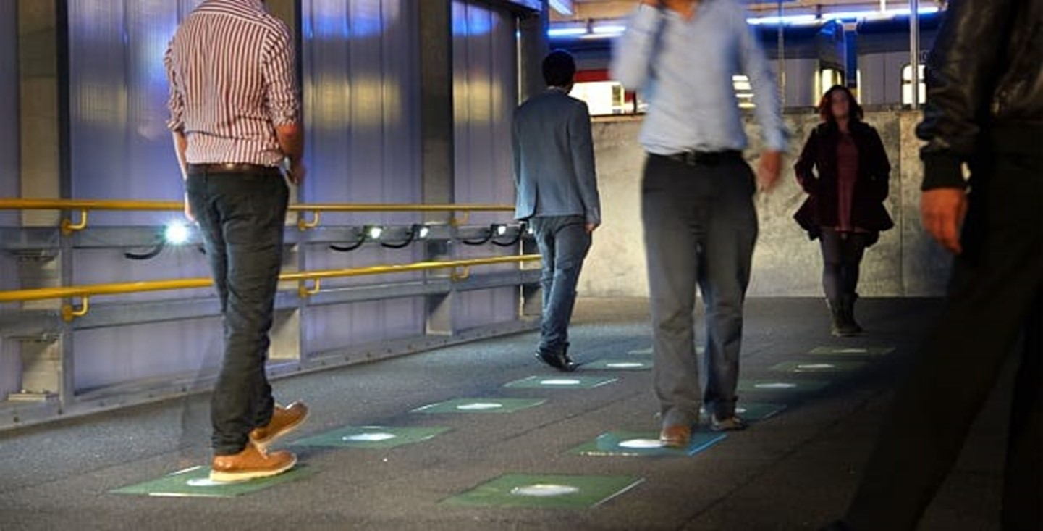
K.RAMAKRISHNAN COLLEGE OF ENGINEERING
(AUTONOMOUS)
EE8611-MINI PROJECT
Human interfaced ambient lighTing system for pedestrial walk ways
Team Members:
811519105001 ABINAYA RS
811519105002 AGALYA V
811519105029 NELSHINI P
811519105038 PRIYADHARSHINI M
811519105040 RESHMA R
811519105042 ROSHINI KJ
Under the guidance of
Mr.G.GABRIEL SANTHOSH KUMAR M.E.,
Assistant Professor
Electrical and Electronics Engineering
K. Ramakrishnan College of Engineering,
An Autonomous Institution
Samayapuram, Tiruchirappalli – 621 112

Slide 2
OVERVIEW
Nowadays many energy resources are getting exhausted and wasted.
Proposal for the utilization of waste energy of foot power with human locomotion is very relevant in populated countries like India where roads, railway stations, bus stands, temples, etc., are overcrowded and millions of peoples move around.
This whole energy is wasted. If this energy may possible for utilization it will be a great invention.
In this project, we are converting non-conventional from just walking force into electrical energy.

Slide 3
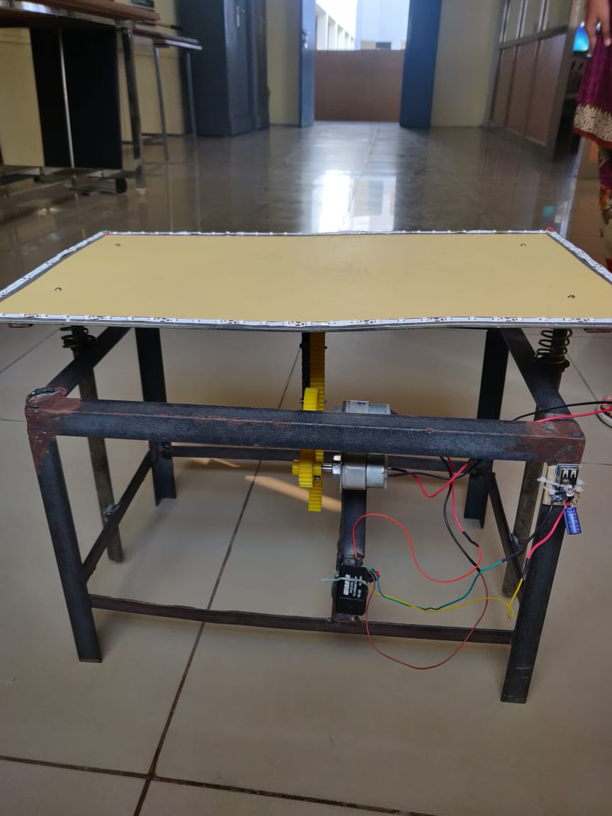
INTRODUCTION
This project uses simple drive mechanism such as rack and pinion assembly.
The control mechanism carries the rack and pinion, and DC generator to output.
Here, we are generating electrical power as non-conventional method by simple walking, running on the footsteps.
Simple drive mechanism is used for generating power by utilization of force which is obtained during walking on steps is converted into electrical energy with the help of mechanical system.

Slide 4
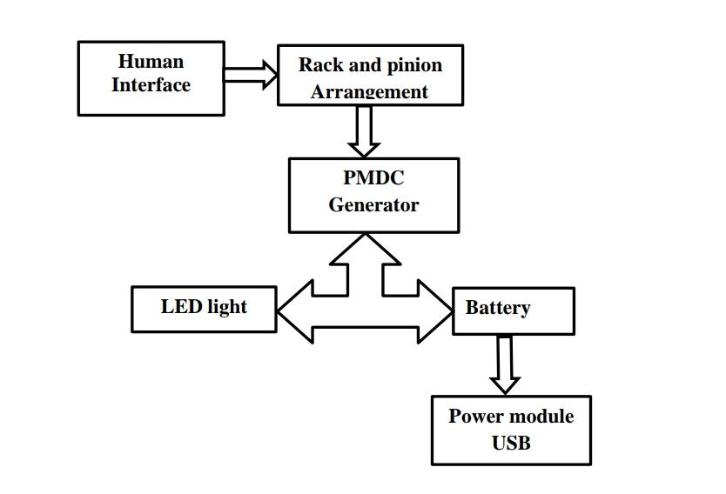
BLOCK DIAGRAM

Slide 5
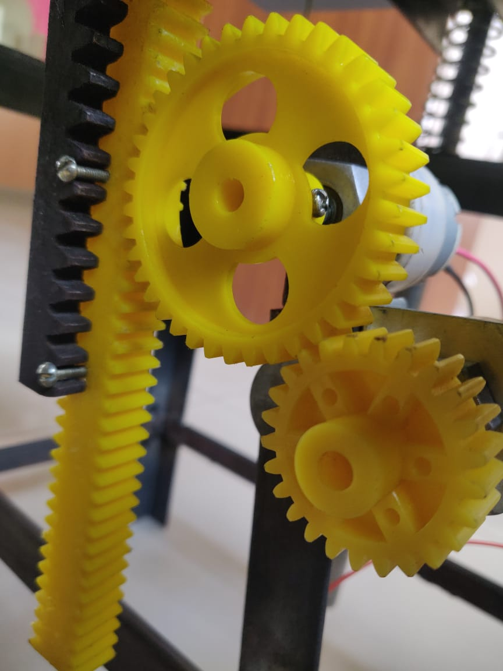
COMPONENTS & ASSEMBLY
The footstep arrangement is used to generate electric power.
Footstep section consists of
Springs
Rack and pinion section
Shaft
Drive mechanism
Coupling section
Dynamo
Load

Slide 6
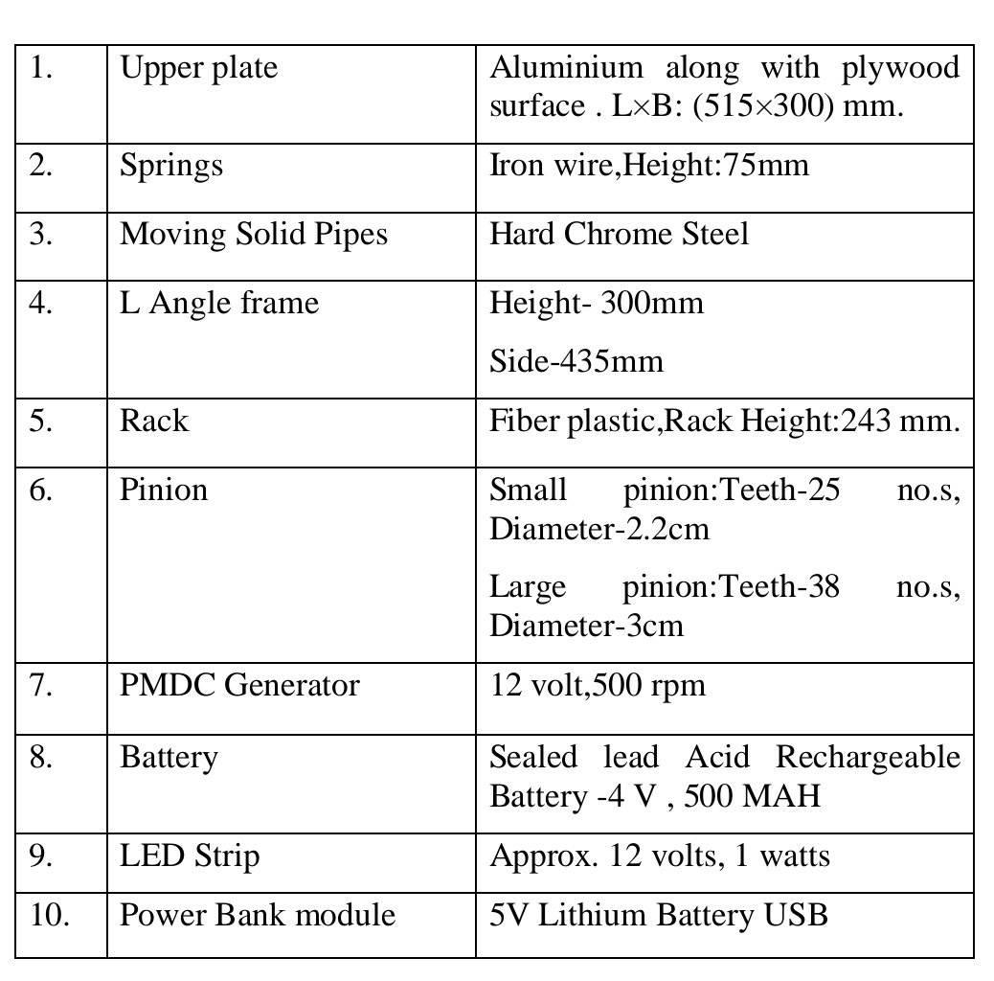
HARDWARE PARTS

Slide 7
Working
Step 1: When force is applied on the top of the plywood surface the spring gets compressed by the force.
Step 2: Due to this compression the rack moves vertically down.
Step 3: The pinion meshed with the rack gear results in circular motion of the pinion gear.
Step 4: For one full compression the pinion Moves one semicircle, when the force applied on the plywood surface is released the pinion reverses and moves another semi- circle.
Step 5: The intermediate gear with more number of teeth will rotate as a result of motion of pinion.
Step 6: The generator attached to the intermediate will obtain the rotating motion,hence results in the production of the electricity
Step 7: The obtained power generation is used to glow the led strip.
Step 8: Also where the power generated is stored in the battery which is used in the power bank module to charge the mobile.

Slide 8
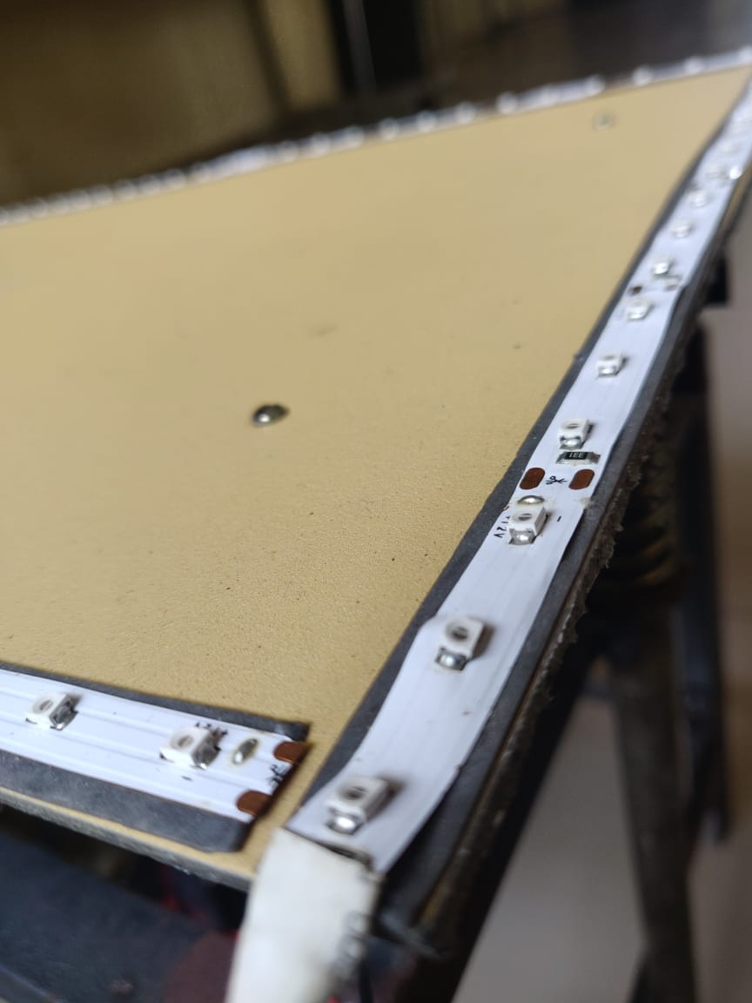
OUTCOMES
LED STRIPS: The force which is given in plywood makes the spring to move and rack moves downwards and upwards which makes pinion to move, where generator generates electric power which makes LED glow.

Slide 9
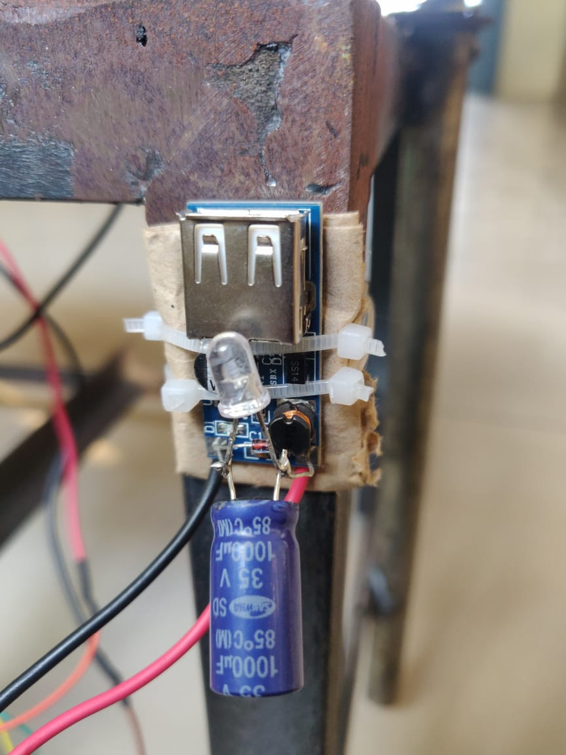
OUTCOMES
POWER MODULE WITH USB: Battery is used to store the electricity received from generator. With the use of power module, mobile can be charged

Slide 10
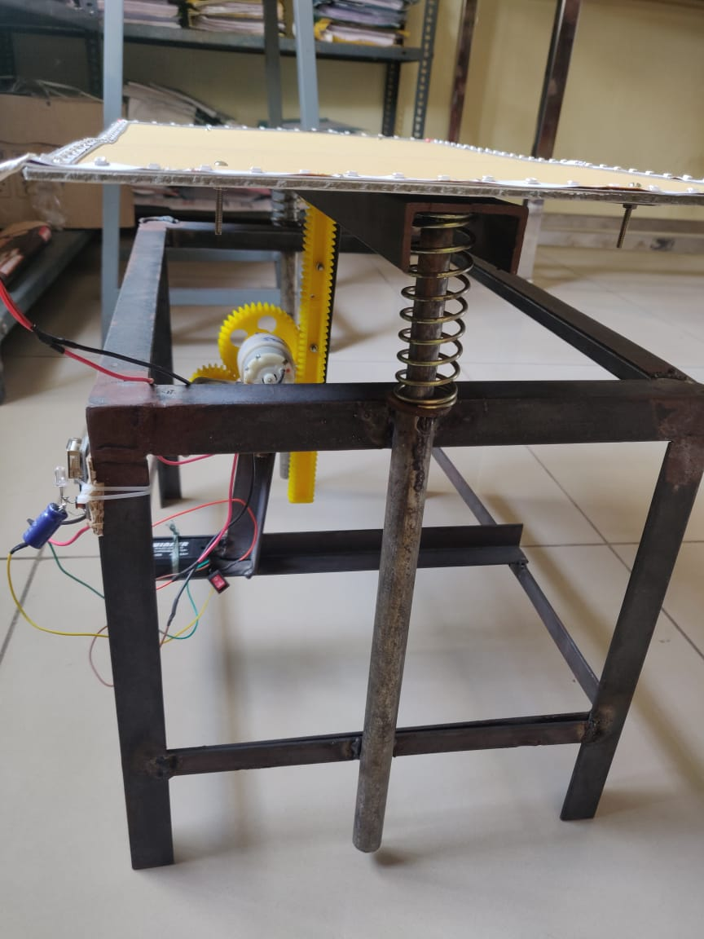
ADVANTAGES
Easy maintenance.
Low cost level.
Reduces transmission losses.
Wide area of applications.
Highly efficient.
Eco-friendly.
Used at any time when it is necessary.
No fuel input.

Slide 11
APPLICATIONS
Railway, Subway Stations
Roads
Temples
Bus stands, Airports
Lift System
Street Lights
Electric Escalator

Slide 12
CONCLUSION
Power generation just by using pressure.
Since In this project of power generation there is not any fuel input requirement for the generation of electric power.
Thus it can be also be concluded that this mode of power generation system is eco-friendly, i.e., No pollution is caused during the generation of power using this type of model.

Slide 13
THANK YOU!

